Slide 1
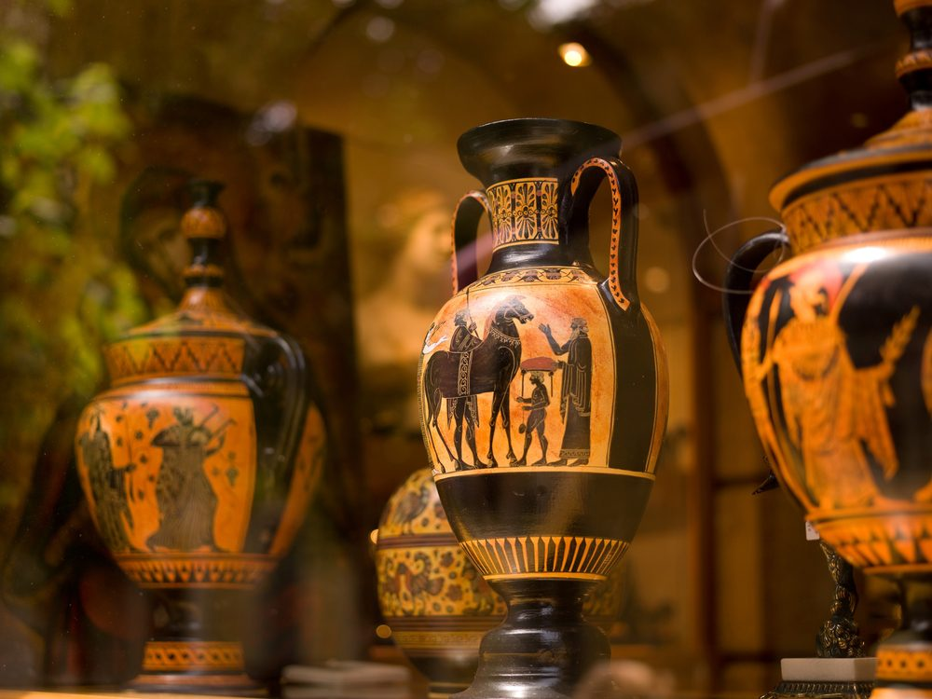

Mobile application to scan and Extract historically and architecturally accurate data of an archaeological object
24-25J-092
12/3/2024 1

Slide 2
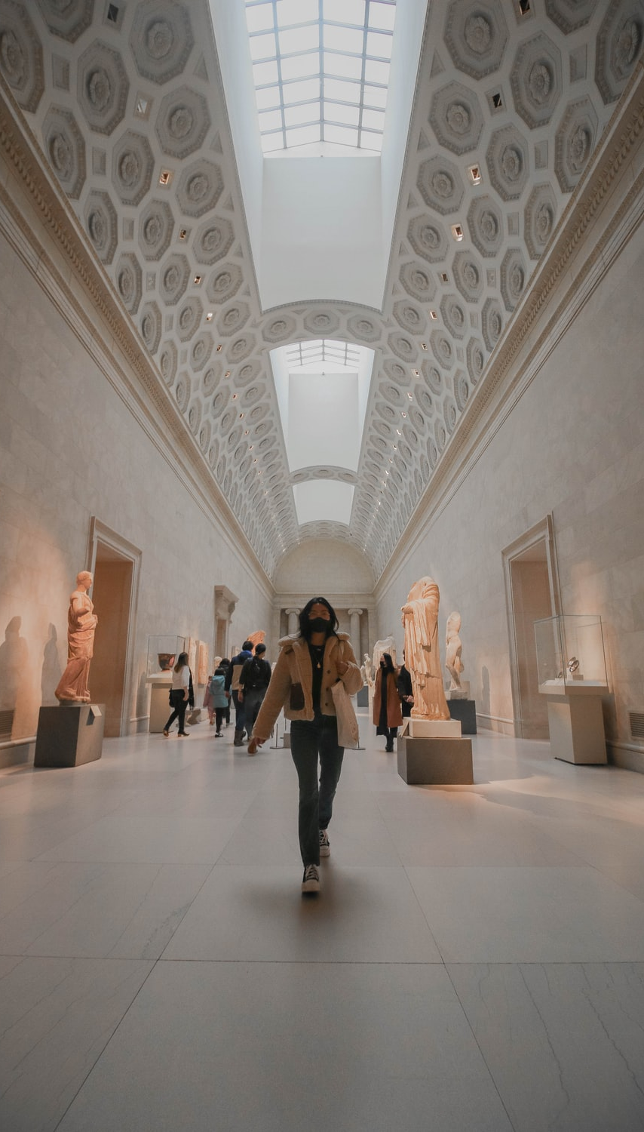
Introduction
The study of archaeological objects is crucial for understanding human history and cultural heritage.
Traditional documentation and analysis methods are - Time-consuming , Require specialized equipment , Prone to human error.
The research focuses on developing a mobile application to - Scan archaeological objects , Extract historically and architecturally accurate data.

Slide 3
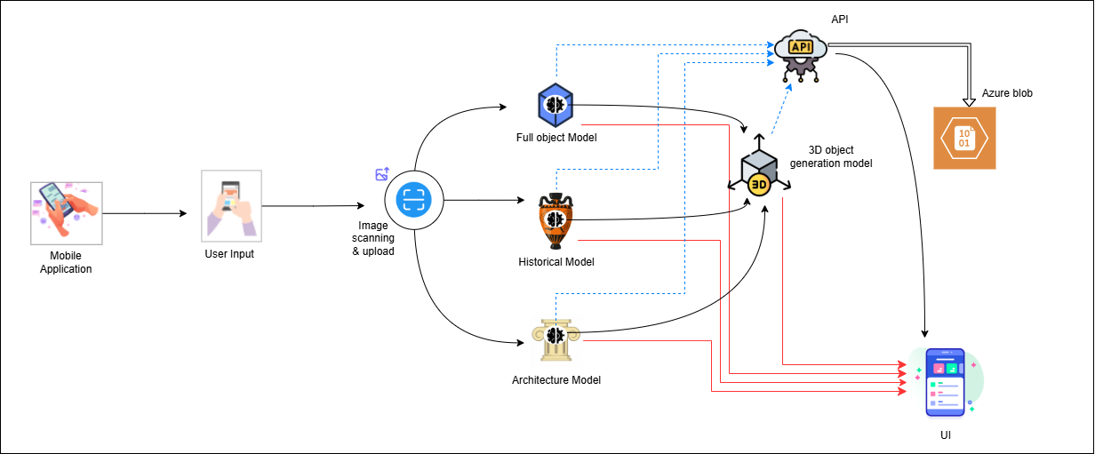
Overall System Diagram

Slide 4

IT21344824 | T.E.M.A.P. Ekanayake
Specialization : Information Technology
IT21344824 | T.E.M.A.P. Ekanayake | 24-25J-092
13/8/2024

Slide 5

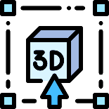


Introduction & Background
3D Object prompt generation
Preservation and study of archaeological objects are vital for understanding human history and cultural heritage
Traditional documentation methods are time-consuming and lack efficiency
Generating accurate 3D models from 2D images enhances artifact analysis and preservation.
Detailed 3D models provide a more comprehensive understanding of archaeological artifacts.
IT21344824 | T.E.M.A.P. Ekanayake | 24-25J-092
13/8/2024

Slide 6
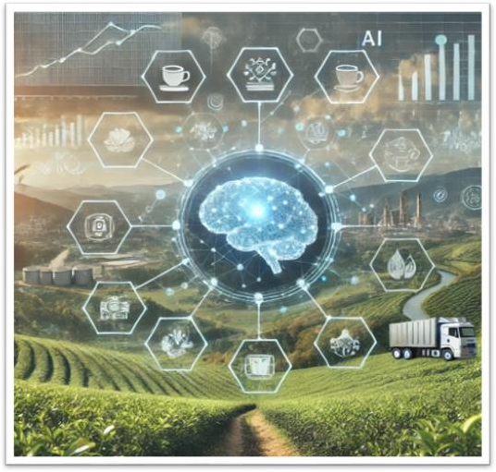
Research Question
How to generate precise and detailed 3D models of archaeological objects from 2D images using mobile applications?
IT21344824 | T.E.M.A.P. Ekanayake | 24-25J-092
13/8/2024

Slide 7
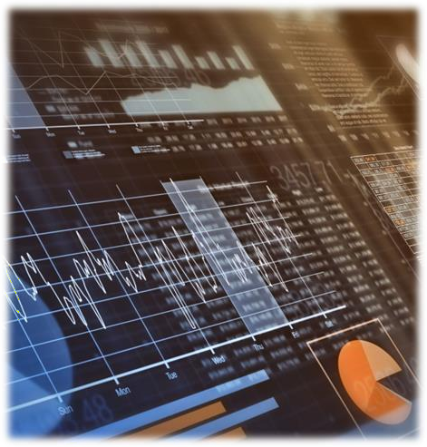
Specific and Sub Objective
Specific Objective
Develop algorithms to convert 2D images into accurate 3D models of archaeological objects.
Sub Objective
Implement texture mapping to preserve the object's surface details.
Optimize the 3D generation process for mobile devices.
IT21344824 | T.E.M.A.P. Ekanayake | 24-25J-092
13/8/2024

Slide 8
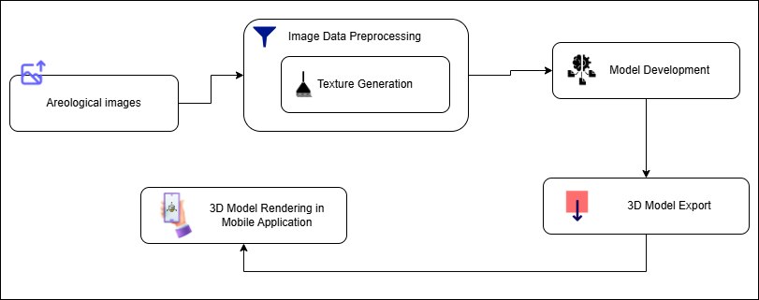
Methodology System Diagram
IT21344824 | T.E.M.A.P. Ekanayake | 24-25J-092
13/8/2024

Slide 9

Methodology
Data
Collection
Model
Development
System Design
Testing and
Validation
Deployment
Gather high-resolution 2D images of archaeological artifacts from museum
Develop and train a CNN-based model to generate 3D archaeological objects
Create a Mobile application to generation and rendering 3D model
Evaluate the system through component-level testing, artifact accuracy checks
Deploy the application with cloud support for scalable processing and storage of 3D models
IT21344824 | T.E.M.A.P. Ekanayake | 24-25J-092
13/8/2024

Slide 10

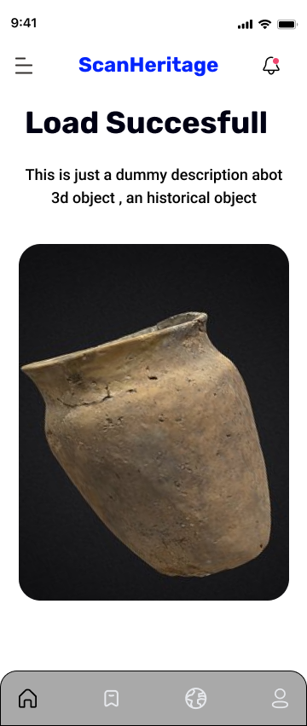
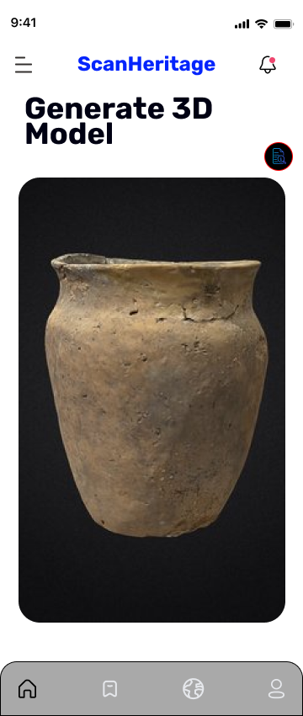
Figma Design
IT21344824 | T.E.M.A.P. Ekanayake | 24-25J-092
13/8/2024

Slide 11
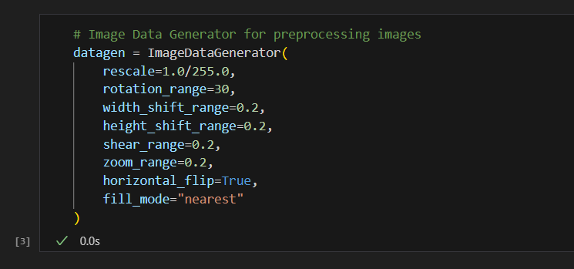
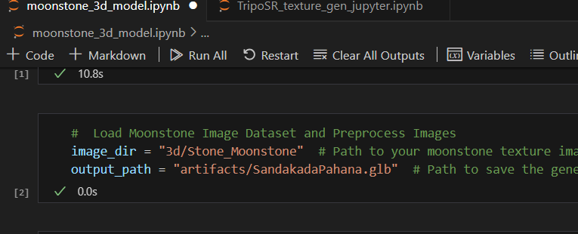
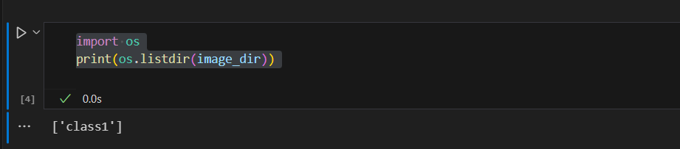
Methodology Evidence of Completion
Data preprocessing
IT21344824 | T.E.M.A.P. Ekanayake | 24-25J-092
13/8/2024

Slide 12
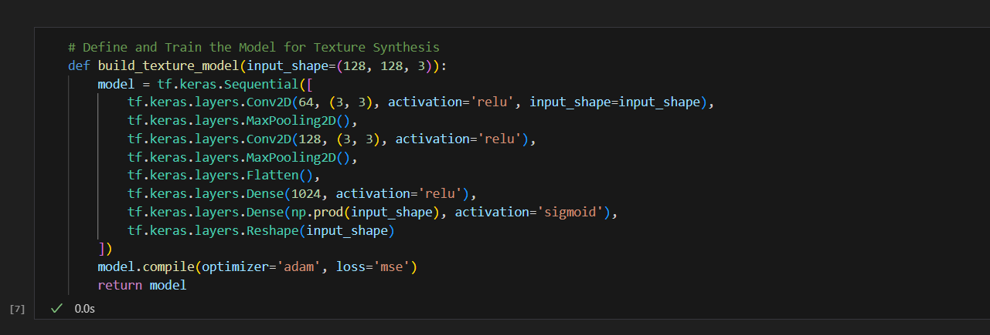
Methodology Evidence of Completion
Model Development and Training
IT21344824 | T.E.M.A.P. Ekanayake | 24-25J-092
13/8/2024

Slide 13
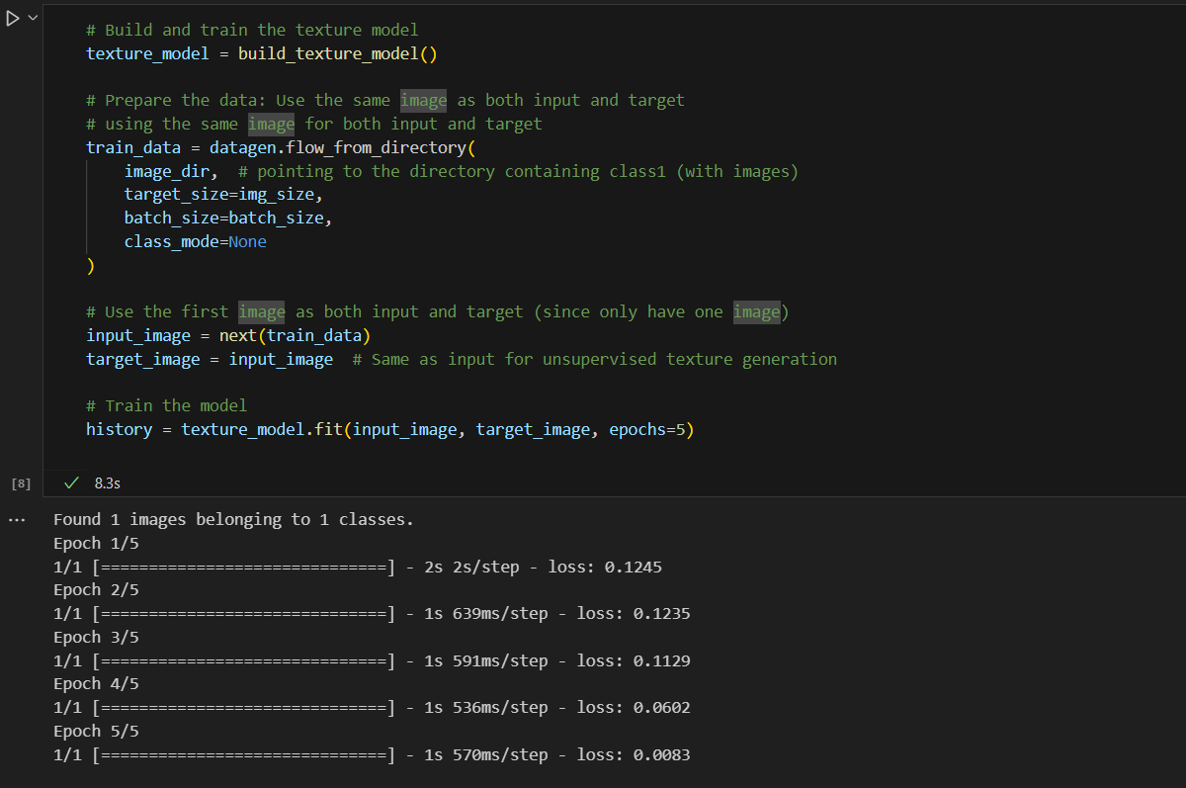
IT21344824 | T.E.M.A.P. Ekanayake | 24-25J-092
13/8/2024

Slide 14
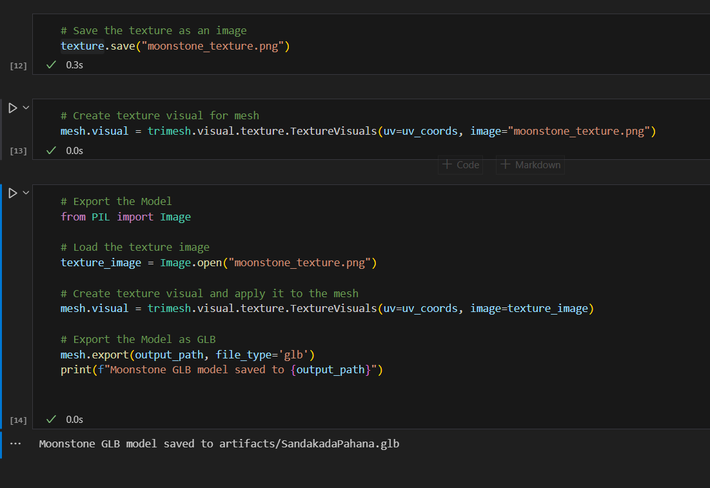
Methodology Evidence of Completion
Export 3D model
IT21344824 | T.E.M.A.P. Ekanayake | 24-25J-092
13/8/2024

Slide 15
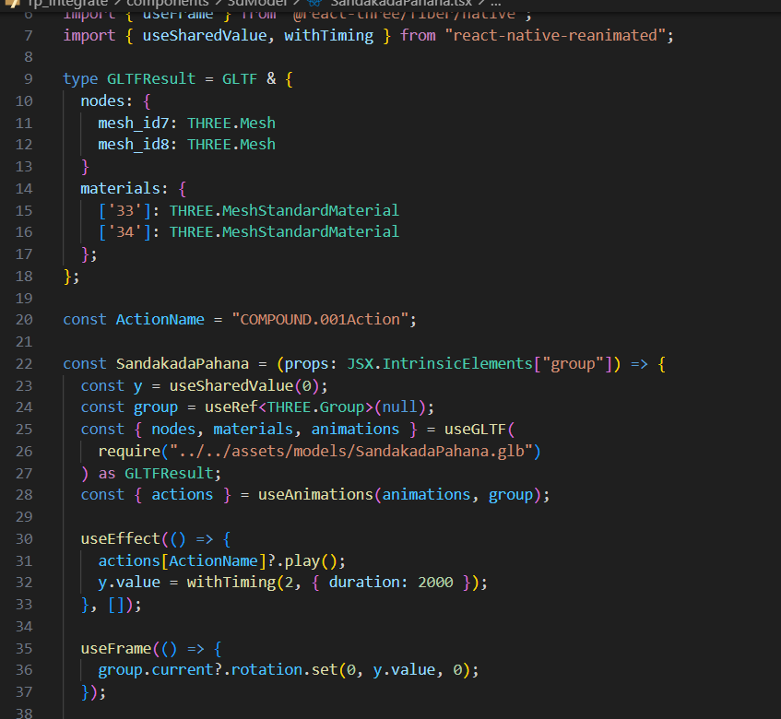
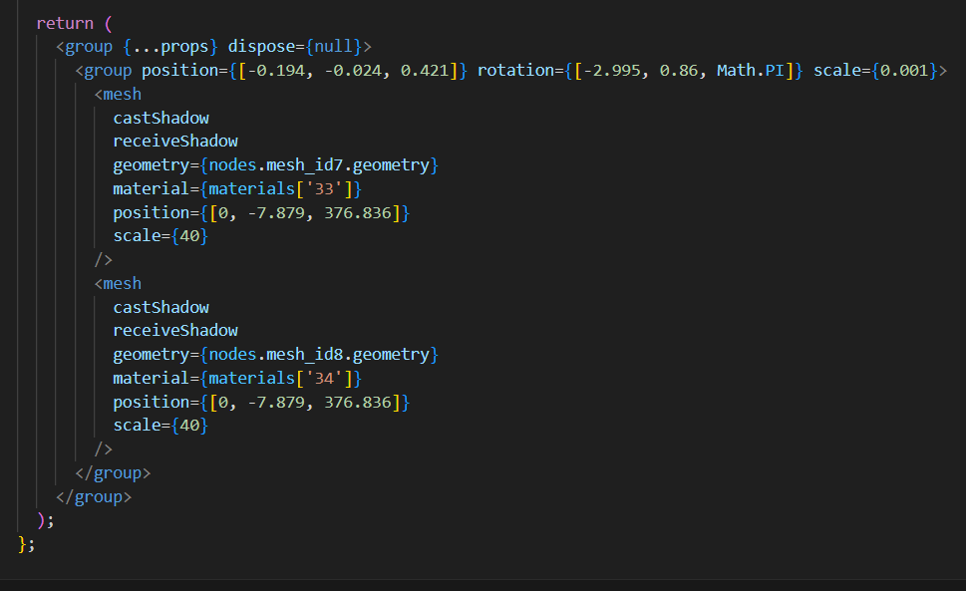
Methodology Evidence of Completion
Integration with Mobile Application
IT21344824 | T.E.M.A.P. Ekanayake | 24-25J-092
13/8/2024

Slide 16
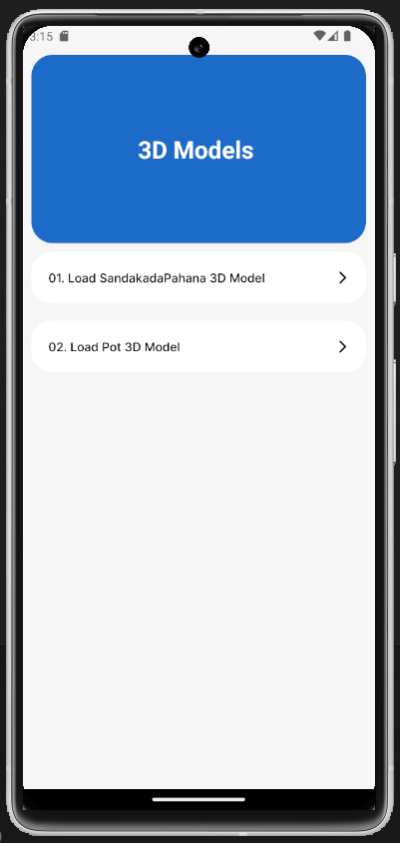
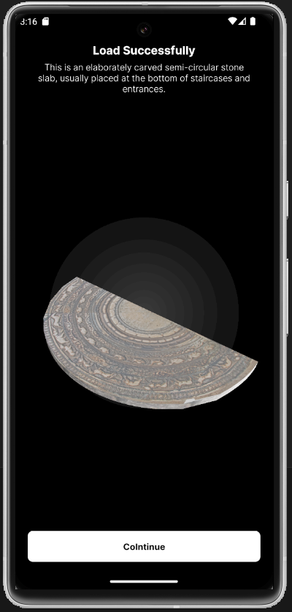
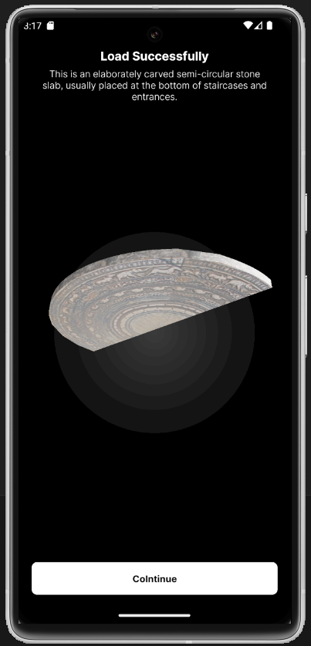
Integration with Mobile Application
Methodology Evidence of Completion
IT21344824 | T.E.M.A.P. Ekanayake | 24-25J-092
13/8/2024

Slide 17
Used Techniques and Technologies
Technologies
React Native
TensorFlow
Trimesh
Three.js
React Three Fiber
PyGLTFLib
Jupyter Notebook
Google Colab
PIL(Pillow)
NumPy
Techniques
Data preprocessing
UV Mapping
3D Model Generation
3D Rendering
IT21344824 | T.E.M.A.P. Ekanayake | 24-25J-092
13/8/2024

Slide 18
Functional, Non-Functional and Requirements
Functional Requirements
Algorithm Development : Develop algorithms to accurately convert 2D images into 3D models
Mobile Optimization : Optimize the 3D object generation process for mobile devices
Integration with image Scanning systems.
Non-Functional Requirements
Deliver high-Accuracy 3D models and textures
High availability with minimal downtime
User-friendly interface with clear visualization
Generate and render 3D models within seconds for real-time interaction
IT21344824 | T.E.M.A.P. Ekanayake | 24-25J-092
13/8/2024

Slide 19
Completion of the project
50% Completion of the Components
developed and trained a CNN-based model for texture generation
Applied the generated texture to a 3D sphere mesh using Trimesh
Successfully generated 3D model for "Sandakada Pahana" using texture synthesis.
Exported the model as a GLB file for integration into the mobile application
50% Future Implementations
Integration of Multiple Artifacts
Implement real-time texture generation and mapping during live artifact scanning with mobile device cameras.
Develop user interaction functionalities to rotate, zoom, and view 3D models
Improve model validation and accuracy
IT21344824 | T.E.M.A.P. Ekanayake | 24-25J-092
13/8/2024

Slide 20
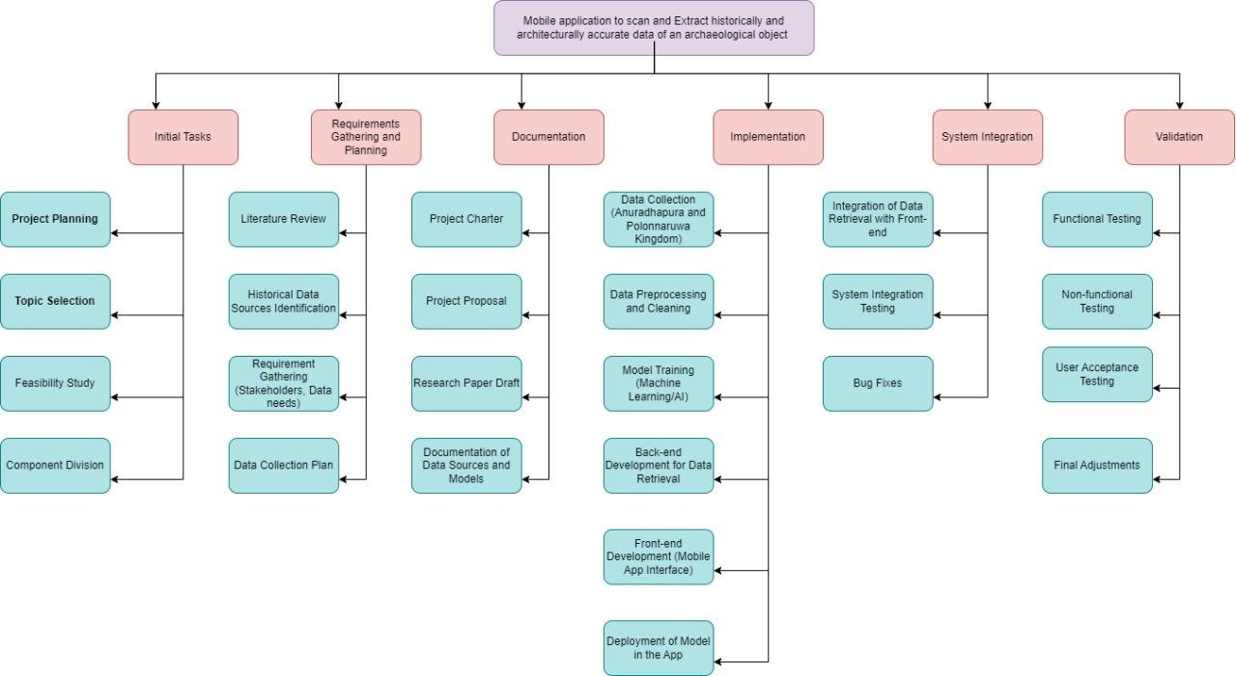
Work Breakdown Structure
IT21344824 | T.E.M.A.P. Ekanayake | 24-25J-092
12/3/2024

Slide 21
References
[1] X. Liu, "Research on 3D Object Reconstruction Method based on Deep Learning," in *Proceedings of the 2nd International Conference on Artificial Intelligence and Computer Engineering (ICAICE)*, Tianjin, China, Dec. 2022, pp. 93-98, doi: 10.1109/ICAICE57299.2022.00024.
[2] K. SusheelKumar, V. B. Semwal, S. Prasad, and R. C. Tripathi, "Generating 3D Model Using 2D Images of an Object," International Journal of Engineering Science and Technology (IJEST), vol. 3, no. 1, pp. 406-409, Jan. 2011.
[3] K. Zhao and A. Larsen, “Challenges and Opportunities in 3D Content Generation,” arXiv preprint arXiv:2405.15335v1, May 2024. Available: https://arxiv.org/abs/2405.15335.
[4] H. Li, Y. Zheng, X. Wu, and Q. Cai, "3D Model Generation and Reconstruction Using Conditional Generative Adversarial Network," *International Journal of Computational Intelligence Systems*, vol. 12, no. 2, pp. 697–705, 2019, doi: 10.2991/ijcis.d.190617.001.

Slide 22



IT21352294 | J.R.K.B. Jayawardhana
Specialization : Information Technology
IT21352294 | J.R.K.B. Jayawardhana | 24-25J-092
13/8/2024

Slide 23
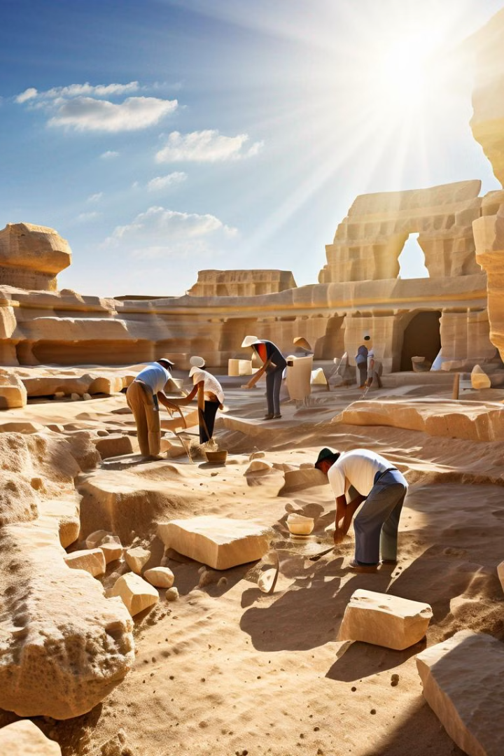
Full Object Detection & Data Retrieve
Introduction & Background
Comprehensive Dataset Collection: Curate a specialized dataset of archaeological objects, capturing unique features for high-quality model training.
Machine Learning Model Training: Train advanced machine learning models, particularly CNNs, to accurately recognize and classify archaeological artifacts.
Novelty : competitors like Google Art have a virtual tour of for historical object but not focus on the sri lankan historical objects but this project we are only focus on sri lankan historical objects.
API Development and Continuous Updates: Develop an API for mobile app integration and continuously update models with new data for accuracy and relevance.
IT21352294 | Jayawardhana J.R.K.B | 24-25J-092
13/8/2024

Slide 24
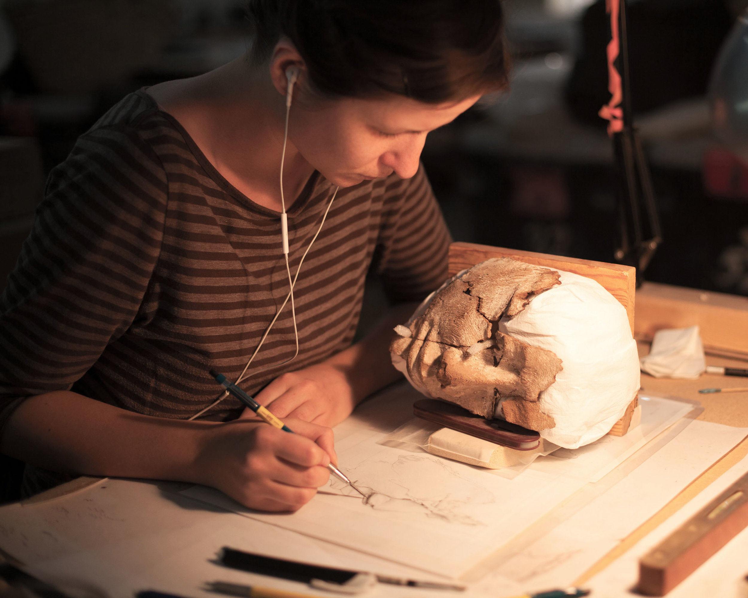
Research Question
How can machine learning and historical data integration improve the accuracy and contextual understanding of archaeological object recognition?
IT21352294 | J.R.K.B. Jayawardhana | 24-25J-092
13/8/2024

Slide 25
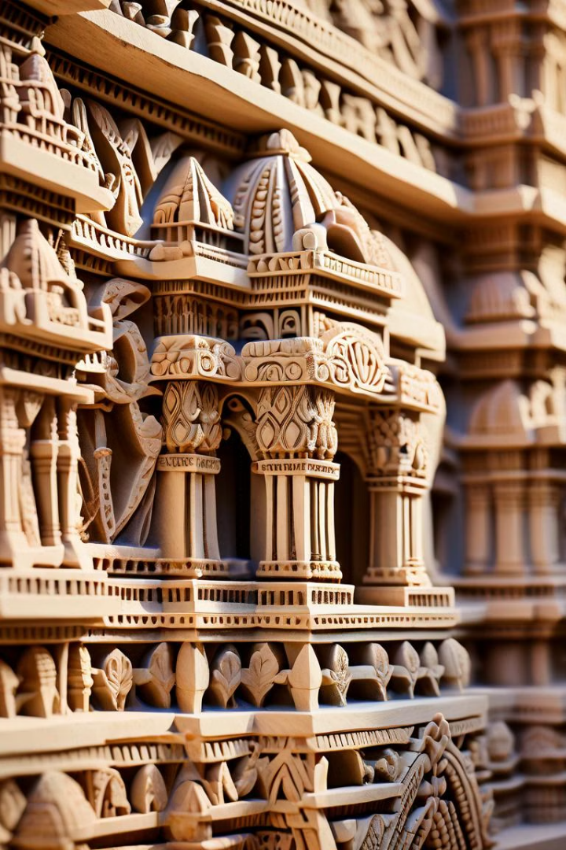
Specific & Sub Objectives
Specific Objective
To create and refine a machine learning model that accurately detects and predicts object features using historical data, ensuring efficient data retrieval and continuous model enhancement.
Sub Objective
Enhance Data Quality: Preprocess and annotate historical data to improve the accuracy of model training.
Optimize Model Algorithms: Select and fine-tune algorithms for better feature detection and prediction.
Efficient Data Retrieval: Develop a system for quick and accurate retrieval of historical data to support model predictions and user needs
IT21352294 | J.R.K.B. Jayawardhana | 24-25J-092
13/8/2024

Slide 26
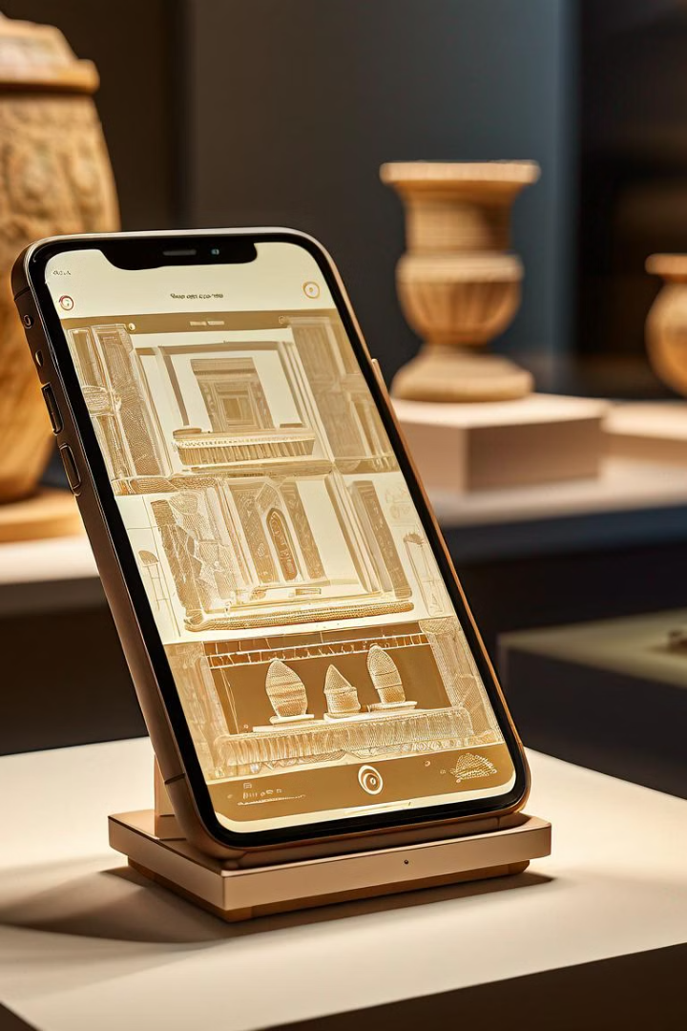
Proposed System Overview
1
Data Collection
Historical data related to the objects is gathered from various sources.
2
Data Preprocessing
Collected data is cleaned and processed to remove noise and inconsistencies.
3
Model Training
Machine learning models are trained using the processed historical data
to identify patterns and make predictions.
4
Data Retrieval & Output
The system retrieves relevant historical data and presents it for analysis or further use.
IT21352294 | J.R.K.B. Jayawardhana | 24-25J-092
13/8/2024

Slide 27
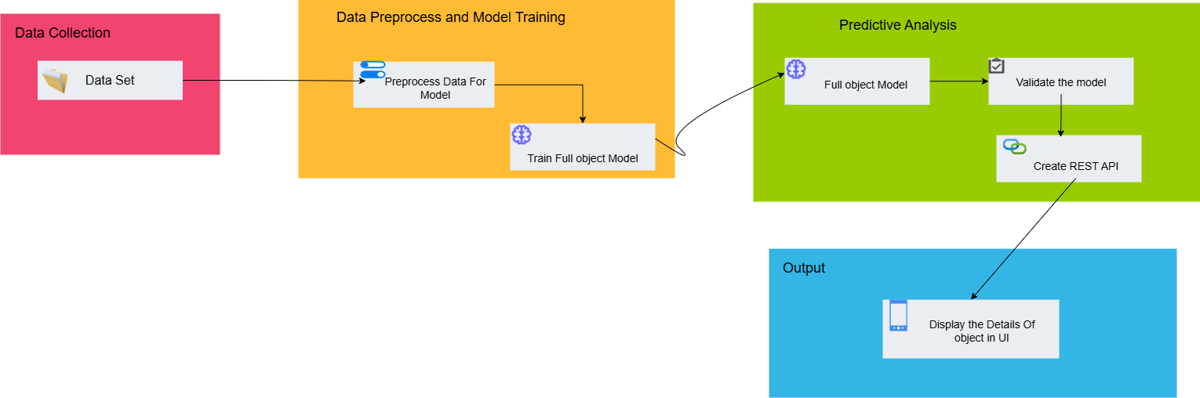
System Diagram
IT21352294 | J.R.K.B. Jayawardhana | 24-25J-092
13/8/2024

Slide 28
Methodology
Data
Collection
Model
Development
System Design
Testing and
Validation
Deployment
Gather high-resolution 2D images and detail of archaeological artifacts from the museum
Develop and train a CNN-based model to archaeological objects
Create a Mobile application for scanning and showing full object details
Evaluate the system through component-level testing, artifact accuracy checks
Deploy the application with cloud support for scalable processing model
IT21352294 | J.R.K.B. Jayawardhana | 24-25J-092
13/8/2024

Slide 29
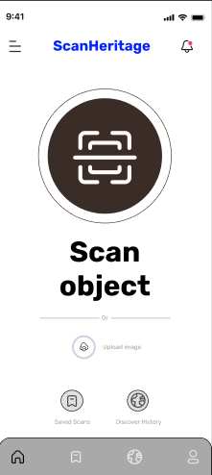
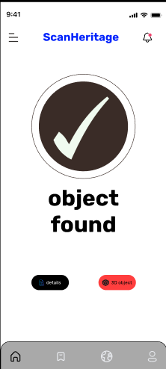
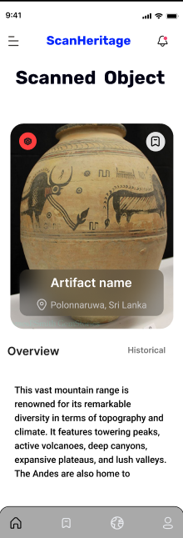
Figma Design
IT21352294 | J.R.K.B. Jayawardhana | 24-25J-092
13/8/2024

Slide 30
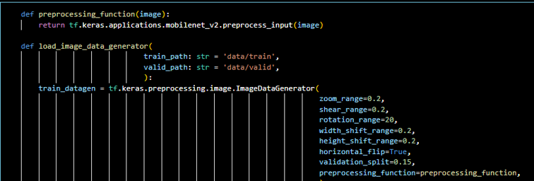
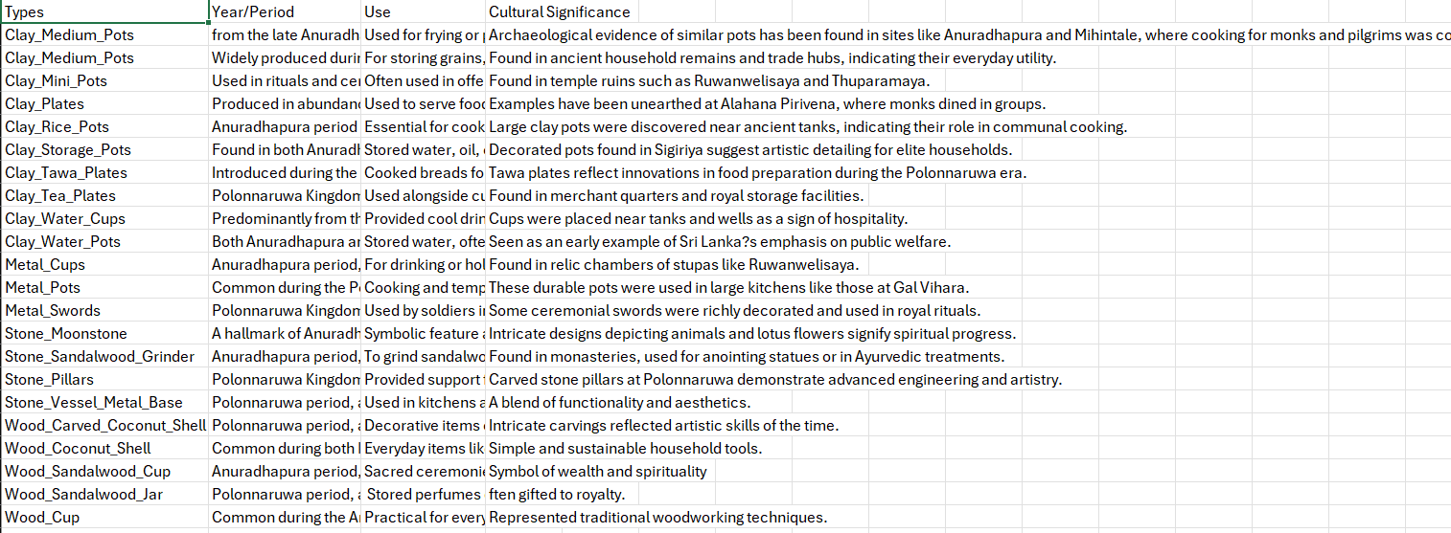
Methodology Evidence of Completion
Data preprocessing & Data Collection
IT21352294 | J.R.K.B. Jayawardhana | 24-25J-092
13/8/2024

Slide 31
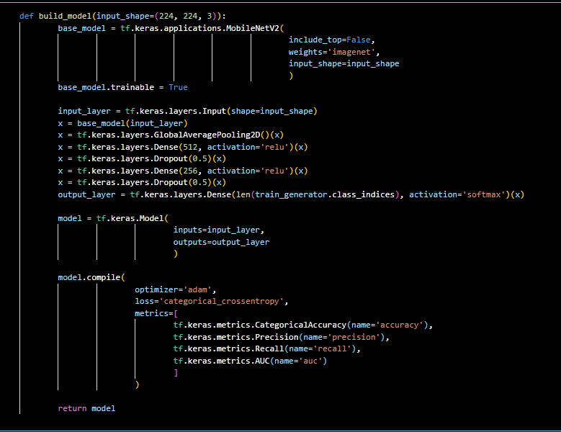
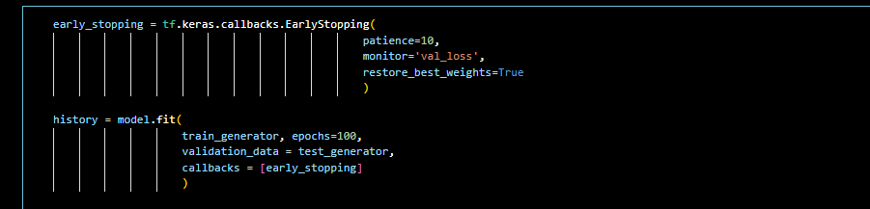

Methodology Evidence of Completion
Model Development and Training
IT21352294 | J.R.K.B. Jayawardhana | 24-25J-092
13/8/2024

Slide 32
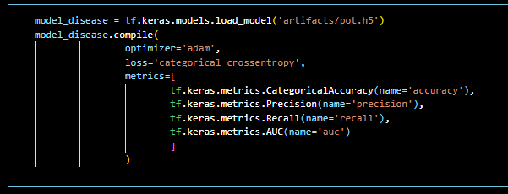
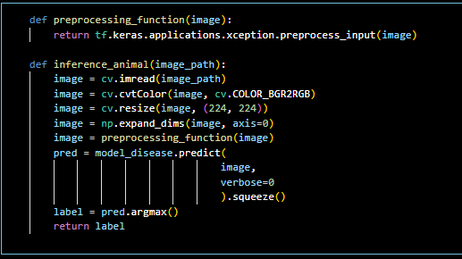
Methodology Evidence of Completion
Data Prediction
IT21352294 | J.R.K.B. Jayawardhana | 24-25J-092
13/8/2024

Slide 33
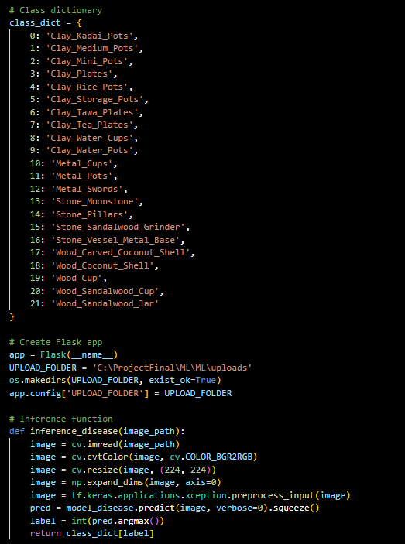
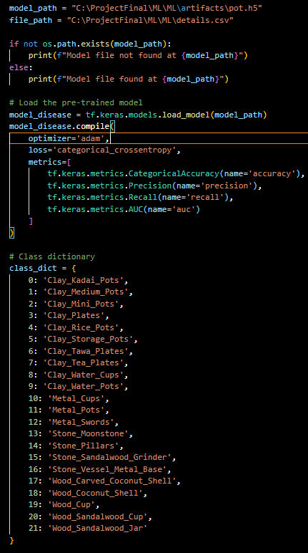
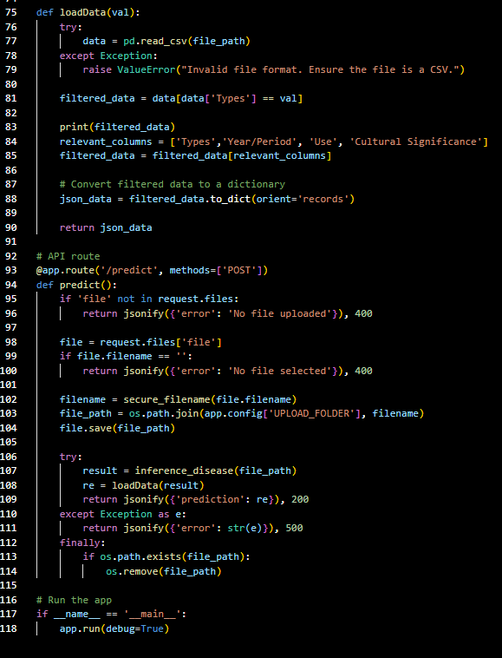
Methodology Evidence of Completion
Create a Flask & API in app.py
IT21352294 | J.R.K.B. Jayawardhana | 24-25J-092
13/8/2024

Slide 34
Used Techniques and Technologies
Technologies
TensorFlow
React Native
Jupyter Notebook
matplotlib
Pandas
NumPy
seaborn
Techniques
Data preprocessing
Data Visualization
IT21352294 | J.R.K.B. Jayawardhana | 24-25J-092
13/8/2024

Slide 35
Requirements
System requirements
Hardware: Intel Core i7/Ryzen 7, NVIDIA RTX 3060, 16 GB RAM, 512 GB SSD (primary), 256 GB SSD/external/cloud storage (secondary), reliable internet (50 Mbps)
Software: Windows, Python , TensorFlow, Jupyter Notebook, RESTful APIs, Git.
Non-functional requirements
Performance
Reliability
Scalability
Security
Usability
Maintainability
Accuracy
functional requirements
User Interface: Intuitive UI for data input, training, and results visualization.
Data Management: Efficient storage with lightweight databases and data compression.
.
IT21352294 | J.R.K.B. Jayawardhana | 24-25J-092
13/8/2024

Slide 36
Completion of the project
50% Completion of the Components
developed and trained a CNN-based model for texture generation
Generate the h.5 file for the model.
Data predictive and create the flask and API created on app.py file.
Can API run potman and can get the details of each object.
50% Future Implementations
Add more data and increase the accuracy of the model.
Create the API for all the models.
Integration with the mobile app and GIT.
Improve model validation.
IT21352294 | J.R.K.B. Jayawardhana | 24-25J-092
13/8/2024

Slide 37
References
[1] A. Wijesuriya and S. G. Ranawana, "Building a comprehensive digital heritage archive for the Anuradhapura Kingdom of Sri Lanka," Journal of Archaeological Science, vol. 58, pp. 45-55, 2020.
[2] M. K. Jayawardene, T. Gunaratne, and H. W. Senanayake, "Multimodal archaeological data integration: A case study on the Anuradhapura Kingdom," Journal of Cultural Heritage, vol. 24, pp. 223-232, 2021. [3] P. S. Kumara and N. G. Pathirana, "Revisiting the Anuradhapura Kingdom: The importance of minor artifacts in archaeological research," International Journal of Archaeology, vol. 12, no. 4, pp. 275-288, 2021.
[4] A. K. Verma, S. Gupta, and M. Singh, "Training Convolutional Neural Networks for the Classification of Archaeological Artifacts," IEEE Transactions on Image Processing, vol. 29, no. 7, pp. 3456–3468, Jul. 2020.
IT21352294 | J.R.K.B. Jayawardhana | 24-25J-092
13/8/2024

Slide 38

IT21360978 | Serasinghe G.P.G.Y
Specialization : Information Technology
IT21360978 | Serasinghe G.P.G.Y | 24-25J-092
28/11/2024

Slide 39




Introduction & Background
Historical Object Detection and Data Retrieval
Detecting and analyzing historical artifacts is key to unlocking the preserving cultural heritage.
Traditional methods of identifying and documenting artifacts can be labor-intensive and prone to human error.
Using machine learning, this research focuses on automating the detection and classification of archaeological objects from images.
extracting and retrieving relevant data from objects allows for a deeper understanding of their historical, cultural significance.
IT21360978 | Serasinghe G.P.G.Y | 24-25J-092
28/11/2024

Slide 40
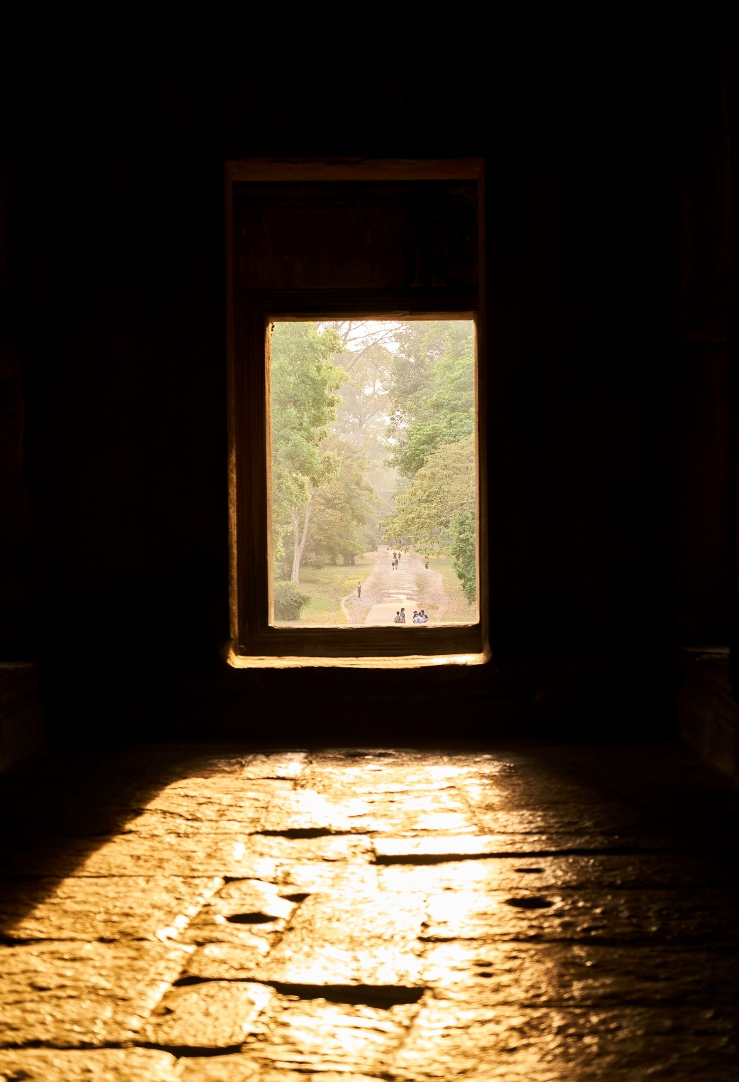
Research Question
How can machine learning techniques be used to accurately detect and classify historical artifacts from 2D images?
IT21360978 | Serasinghe G.P.G.Y | 24-25J-092
28/11/2024

Slide 41
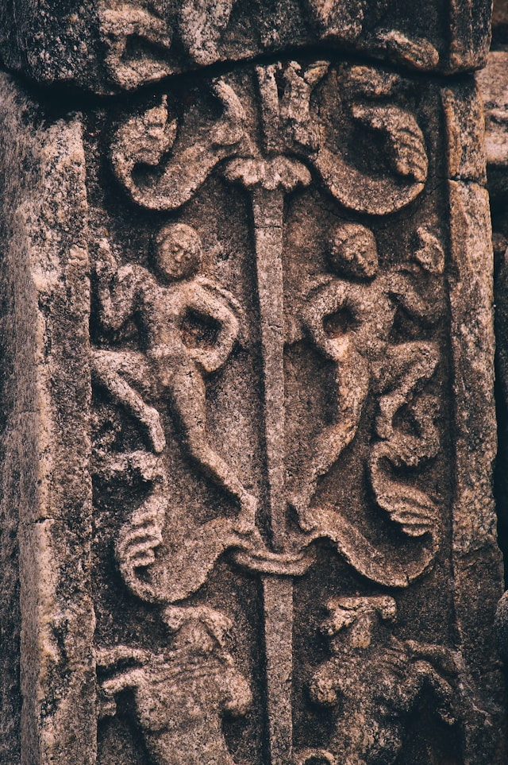
Specific and Sub Objective
Specific Objective
Develop a system for detecting and retrieving historical data from archaeological artifacts using advanced image processing and data extraction techniques.
Sub Objective
Utilizing machine learning techniques to detect and classify artifacts from 2D images.
Extract relevant metadata (e.g., type , purpose) associated with the detected artifacts.
Reduce the time required for data retrieval, making the process more efficient compared to traditional methods.
IT21360978 | Serasinghe G.P.G.Y | 24-25J-092
28/11/2024

Slide 42
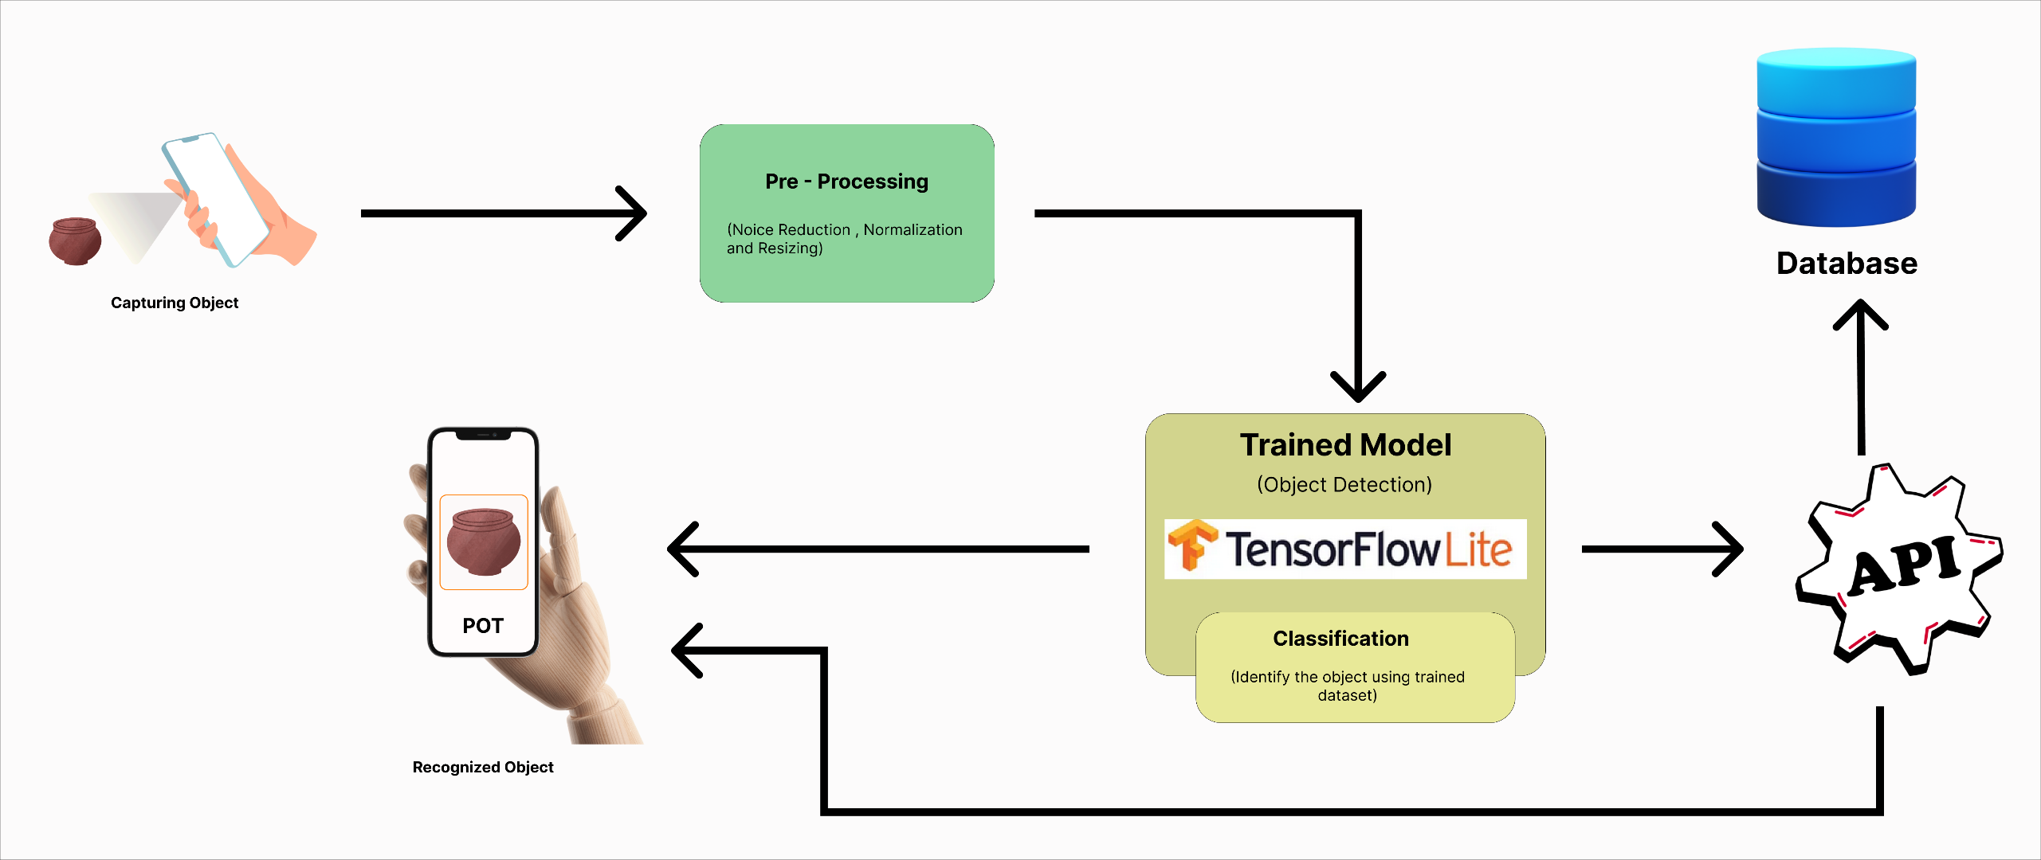
Methodology System Diagram
IT21360978 | Serasinghe G.P.G.Y | 24-25J-092
28/11/2024

Slide 43
Methodology
Data
Collection
Model
Development
System Design
Testing and
Validation
Deployment
High-quality 2D images of archaeological artifacts are collected from museums
Develop and train a CNN-based model to detect and classify the artifacts based on pre-trained datasets.
Create a Mobile application to analyze and visualize the artifacts and their associated data.
Evaluate the system through component-level testing, artifact accuracy checks
Deploy the app with cloud support for historical data storage
IT21360978 | Serasinghe G.P.G.Y | 24-25J-092
28/11/2024

Slide 44
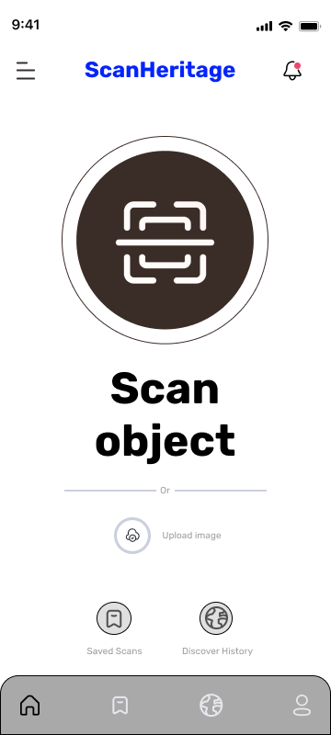
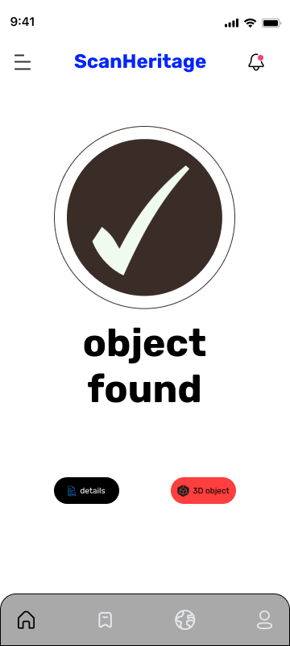
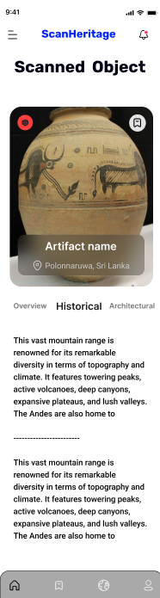
Figma Design
IT21360978 | Serasinghe G.P.G.Y | 24-25J-092
28/11/2024

Slide 45
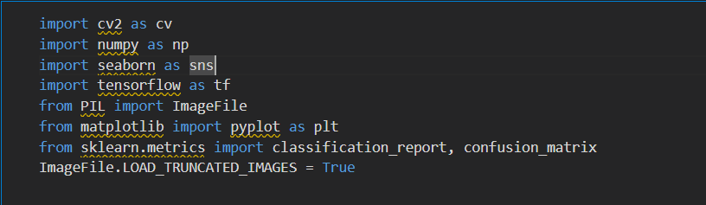
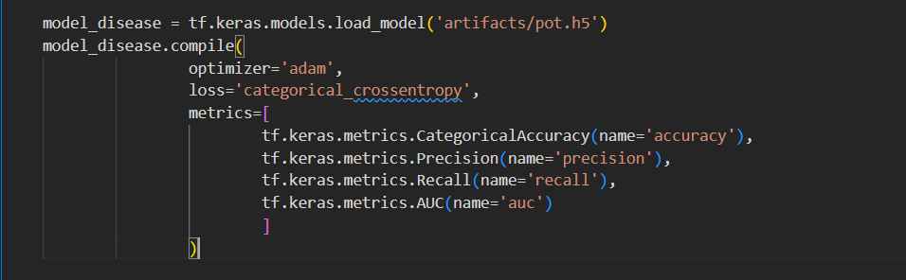
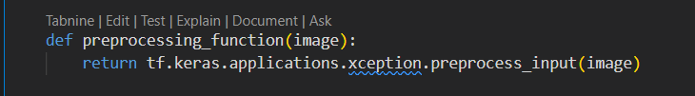
Methodology Evidence of Completion
Evaluation
Importing the required Libraries
Load and compile
Preprocessing Images for model
IT21360978 | Serasinghe G.P.G.Y | 24-25J-092
28/11/2024

Slide 46
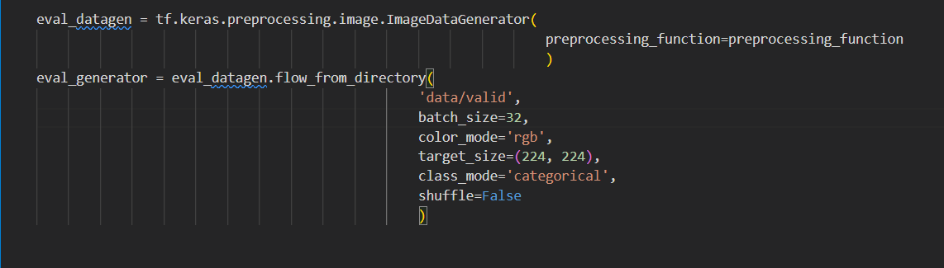
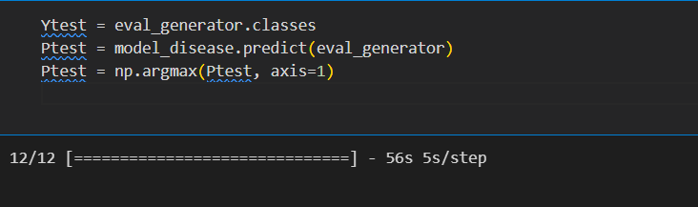
Methodology Evidence of Completion
Evaluate the Dataset
IT21360978 | Serasinghe G.P.G.Y | 24-25J-092
28/11/2024

Slide 47
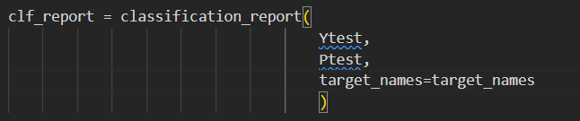

Classification Report
IT21360978 | Serasinghe G.P.G.Y | 24-25J-092
28/11/2024

Slide 48



Single Image Inference
Class wise Accuracy
IT21360978 | Serasinghe G.P.G.Y | 24-25J-092
28/11/2024

Slide 49


Methodology Evidence of Completion
API Development
Import Libraries
Loading the Pre-Trained Model
IT21360978 | Serasinghe G.P.G.Y | 24-25J-092
28/11/2024

Slide 50


Methodology Evidence of Completion
Image Pre-processing and Inference
Load the csv file and filter
IT21360978 | Serasinghe G.P.G.Y | 24-25J-092
28/11/2024

Slide 51


Integration
Methodology Evidence of Completion
User Interface
File upload with API Logic
IT21360978 | Serasinghe G.P.G.Y | 24-25J-092
28/11/2024

Slide 52
Used Techniques and Technologies
Technologies
React Native
TensorFlow
Pytorch
Python
flask
Jupyter Notebook
Google Collab
PIL(Pillow)
NumPy
OpenCV
Git/GitHub
Techniques
Image preprocessing
Object detection and classification
Data retrieval and integration
Data Visualization
IT21360978 | Serasinghe G.P.G.Y | 24-25J-092
28/11/2024

Slide 53
Functional, Non-Functional and Requirements
Functional Requirements
Object Detection : automatically detect and classify archaeological artifacts from high-quality 2D images.
Historical data retrieve : retrieve relevant metadata (e.g., type, use ,year) from connected predefined sources.
Analysis and Reporting : generate detailed reports with historical, cultural, and architectural insights based on detected artifacts.
Non-Functional Requirements
Performance
Reliability
Scalability
Security
Usability
Maintainability
Accuracy
IT21360978 | Serasinghe G.P.G.Y | 24-25J-092
28/11/2024

Slide 54
Completion of the project
50% Completion of the Components
Developed and deployed a CNN-based model for historical artifact detection.
Integrated the model with a Flask API for user-friendly image uploads and real-time predictions.
Mapped detected artifacts to historical and cultural data using a structured CSV database.
50% Future Implementations
Expand the dataset to include more artifact categories for improved classification.
Implement real-time detection and data retrieval during live artifact scanning.
Improve model validation and accuracy
IT21360978 | Serasinghe G.P.G.Y | 24-25J-092
28/11/2024

Slide 55
References
[1] “Object Detection Using Deep Learning, CNNs and Vision Transformers: A review,” IEEE Journals & Magazine | IEEE Xplore, 2023. https://ieeexplore.ieee.org/document/10098596
[2] R. Kaur and S. Singh, “A comprehensive review of object detection with deep learning,” Digital Signal Processing, vol. 132, p. 103812, Jan. 2023, doi: 10.1016/j.dsp.2022.103812.
[3] “Image recognition using machine learning techniques,” IEEE Conference Publication | IEEE Xplore, Sep. 14, 2023. https://ieeexplore.ieee.org/abstract/document/10303370

Slide 56

IT21273094 | Ediriwickrama E.A.K.V.
Specialization : Information Technology
IT21273094 | Ediriwickrama E.A.K.V | 24-25J-092
28/11/2024

Slide 57
Introduction & Background
Architectural Object Detection and Data Retrieval
Detecting and analyzing architectural objects is vital for preserving cultural heritage and understanding historical contexts
Traditional methods are labor-intensive, time-consuming, and prone to error.
This research leverages machine learning to automate the detection and classification of architectural features..
Retrieving and analyzing relevant metadata, it provides deeper insights into the historical, cultural, and architectural significance of these objects.
IT21273094 | Ediriwickrama E.A.K.V | 24-25J-092
28/11/2024

Slide 58

Research Question
How can machine learning techniques be utilized to accurately detect and retrieve architectural data from archaeological objects?
IT21273094 | Ediriwickrama E.A.K.V | 24-25J-092
28/11/2024

Slide 59

Specific and Sub Objective
Specific Objective
Develop a system to detect and retrieve architectural data from archaeological objects using advanced image processing and data extraction techniques.
Sub Objective
Detect architectural features (e.g., arches, columns).
Classify architectural elements into styles and timeline.
Extract and retrieve metadata (e.g., purpose, material)
Reduce data retrieval time compared to traditional methods.
IT21273094 | Ediriwickrama E.A.K.V | 24-25J-092
28/11/2024

Slide 60

Methodology System Diagram
IT21273094 | Ediriwickrama E.A.K.V | 24-25J-092
28/11/2024

Slide 61
Methodology
Data
Collection
Model
Development
System Design
Testing and
Validation
Deployment
Gather high-quality images of architectural features from archaeological sites.
Train a CNN-based model for detecting architectural objects.
Develop a mobile application to retrieve and display the associated data.
Perform validation tests on detection accuracy and data relevance.
Deploy the app with cloud support for architectural data storage
IT21273094 | Ediriwickrama E.A.K.V | 24-25J-092
28/11/2024

Slide 62

Figma Design
IT21273094 | Ediriwickrama E.A.K.V | 24-25J-092
28/11/2024

Slide 63
Methodology Evidence of Completion
Data preprocessing
IT21273094 | Ediriwickrama E.A.K.V | 24-25J-092
28/11/2024

Slide 64
Methodology Evidence of Completion
Model Development and Training
IT21273094 | Ediriwickrama E.A.K.V | 24-25J-092
28/11/2024

Slide 65
Used Techniques and Technologies
Technologies
React Native
TensorFlow
Pytorch
Python
flask
Jupyter Notebook
Google Collab
PIL(Pillow)
NumPy
OpenCV
Git/GitHub
Techniques
Image preprocessing
Architectural Object detection and classification
Data retrieval and integration
IT21273094 | Ediriwickrama E.A.K.V | 24-25J-092
28/11/2024

Slide 66
Functional, Non-Functional and Requirements
Functional Requirements
Object Detection : Detect architectural elements from images
Historical data retrieve : Retrieve and display associated historical data.
Analysis and Reporting : Generate detailed reports with architectural insights.
Non-Functional Requirements
Performance
Reliability
Scalability
Security
Usability
Maintainability
Accuracy
IT21273094 | Ediriwickrama E.A.K.V | 24-25J-092
28/11/2024

Slide 67
Completion of the project
Completion of the Components
Trained CNN model for object detection.
Implemented API for data retrieval.
Future Implementations
Expand the dataset to include more architectural styles.
Improve real-time detection accuracy.
Integrate mobile support for live scanning and retrieval
IT21273094 | Ediriwickrama E.A.K.V | 24-25J-092
28/11/2024

Slide 68
References
[1] M. V. Peppa et al., “ARCHAEOLOGICAL FEATURE DETECTION FROM ARCHIVE AERIAL PHOTOGRAPHY WITH a SFM-MVS AND IMAGE ENHANCEMENT PIPELINE,” the International Archives of the Photogrammetry, Remote Sensing and Spatial Information Sciences/International Archives of the Photogrammetry, Remote Sensing and Spatial Information Sciences, vol. XLII–2, pp. 869–875, May 2018, doi: 10.5194/isprs-archives-xlii-2-869-2018.
[2] M. Altaweel, A. Khelifi, Z. Li, A. Squitieri, T. Basmaji, and M. Ghazal, “Automated Archaeological Feature Detection using Deep Learning on Optical UAV imagery: Preliminary results,” Remote Sensing, vol. 14, no. 3, p. 553, Jan. 2022, doi: 10.3390/rs14030553.

